Slide 1

Getting started…
Please sit in rows A through J only
Form groups of 3-5 students
Discuss: what are you most confused about?
Post questions on Ask For Me!

Slide 2
Sampling Distributions (Continued)
Psych 100A Spring 2019
Prof. Jim Stigler

Slide 3
This Week
What are sampling distributions?
Why do we need them?
How do do we make them?
How do we use them?

Slide 4
A sampling distribution is a distribution of sample statistics,
or estimates.

Slide 5
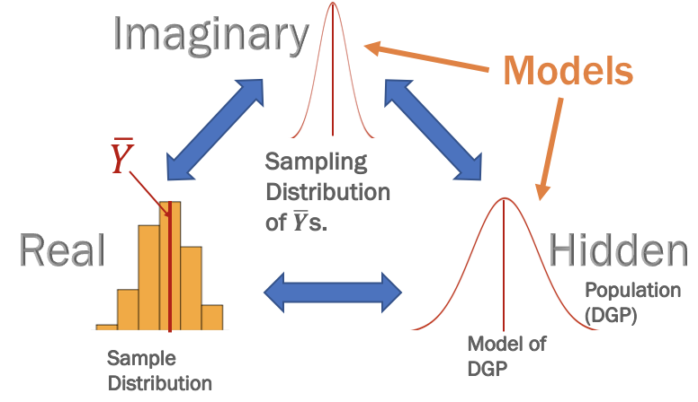
Distribution Triad: What Distribution do Estimates Come From?
A sampling distribution is a model of the distribution of estimates.
Notes:
What is a statistical model? How does it fit with other psychology models?
We have theories...
But most of them are probabalistic...
A statistical model is a way to
Explain variation
Estimate the parameters of the DGP
Quantify how far off our estimates might be
Rule out chance variation in sampling as an explanation

Slide 6
Any parameter estimate can be thought of as coming from a sampling distribution of all possible samples of the same size that could have been drawn from the same DGP.

Slide 7
Why We Need a Sampling Distribution

Slide 8
A sampling distribution provides
the context for interpreting a sample statistic (parameter estimate).

Slide 9
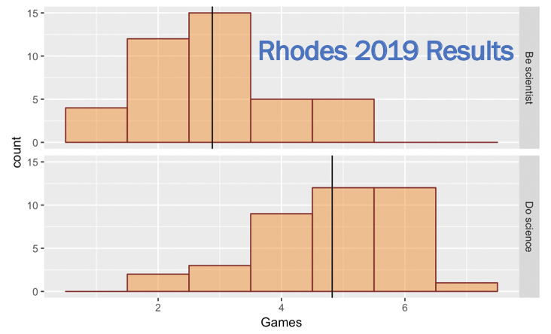
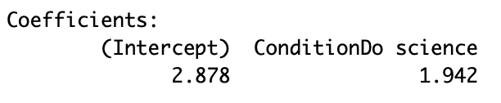
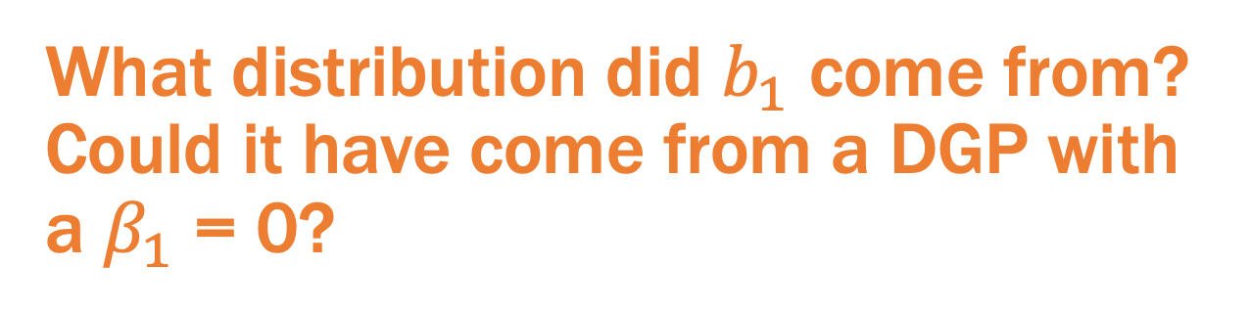
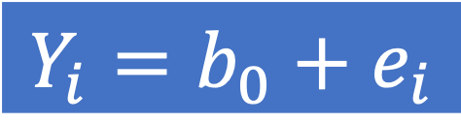

$$Y_{i}=b_{0}+b_{1}X_{i}+e_{i}$$
$$Y_{i}=b_{0}+e_{i}$$
What distribution did $b_{1}$ come from? Could it have come from a DGP with a $β_{1}$ = 0?

Slide 10
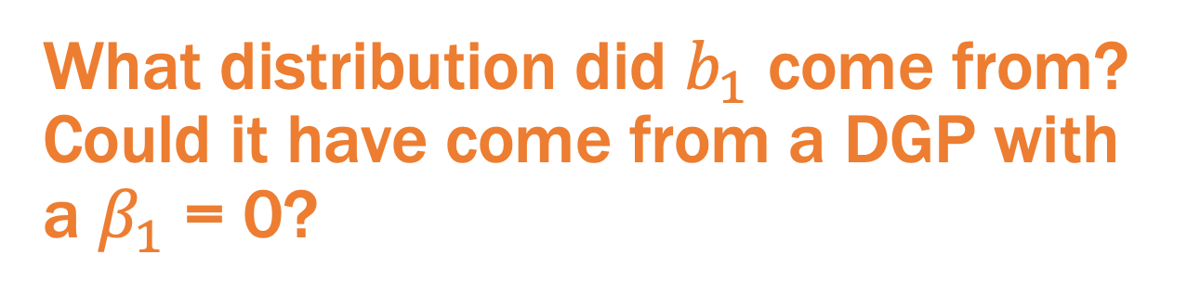
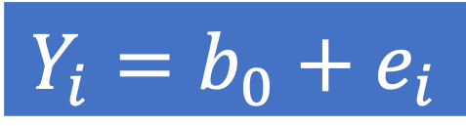
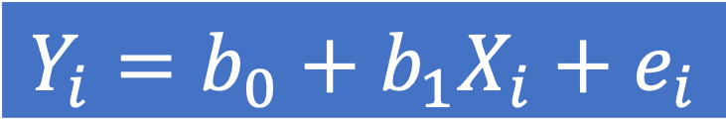
$$Y_{i}=b_{0}+b_{1}X_{i}+e_{i}$$
$$Y_{i}=b_{0}+e_{i}$$
What distribution did $b_{1}$ come from? Could it have come from a DGP with a $β_{1}$ = 0?
Draw a picture to represent this question.

Slide 11
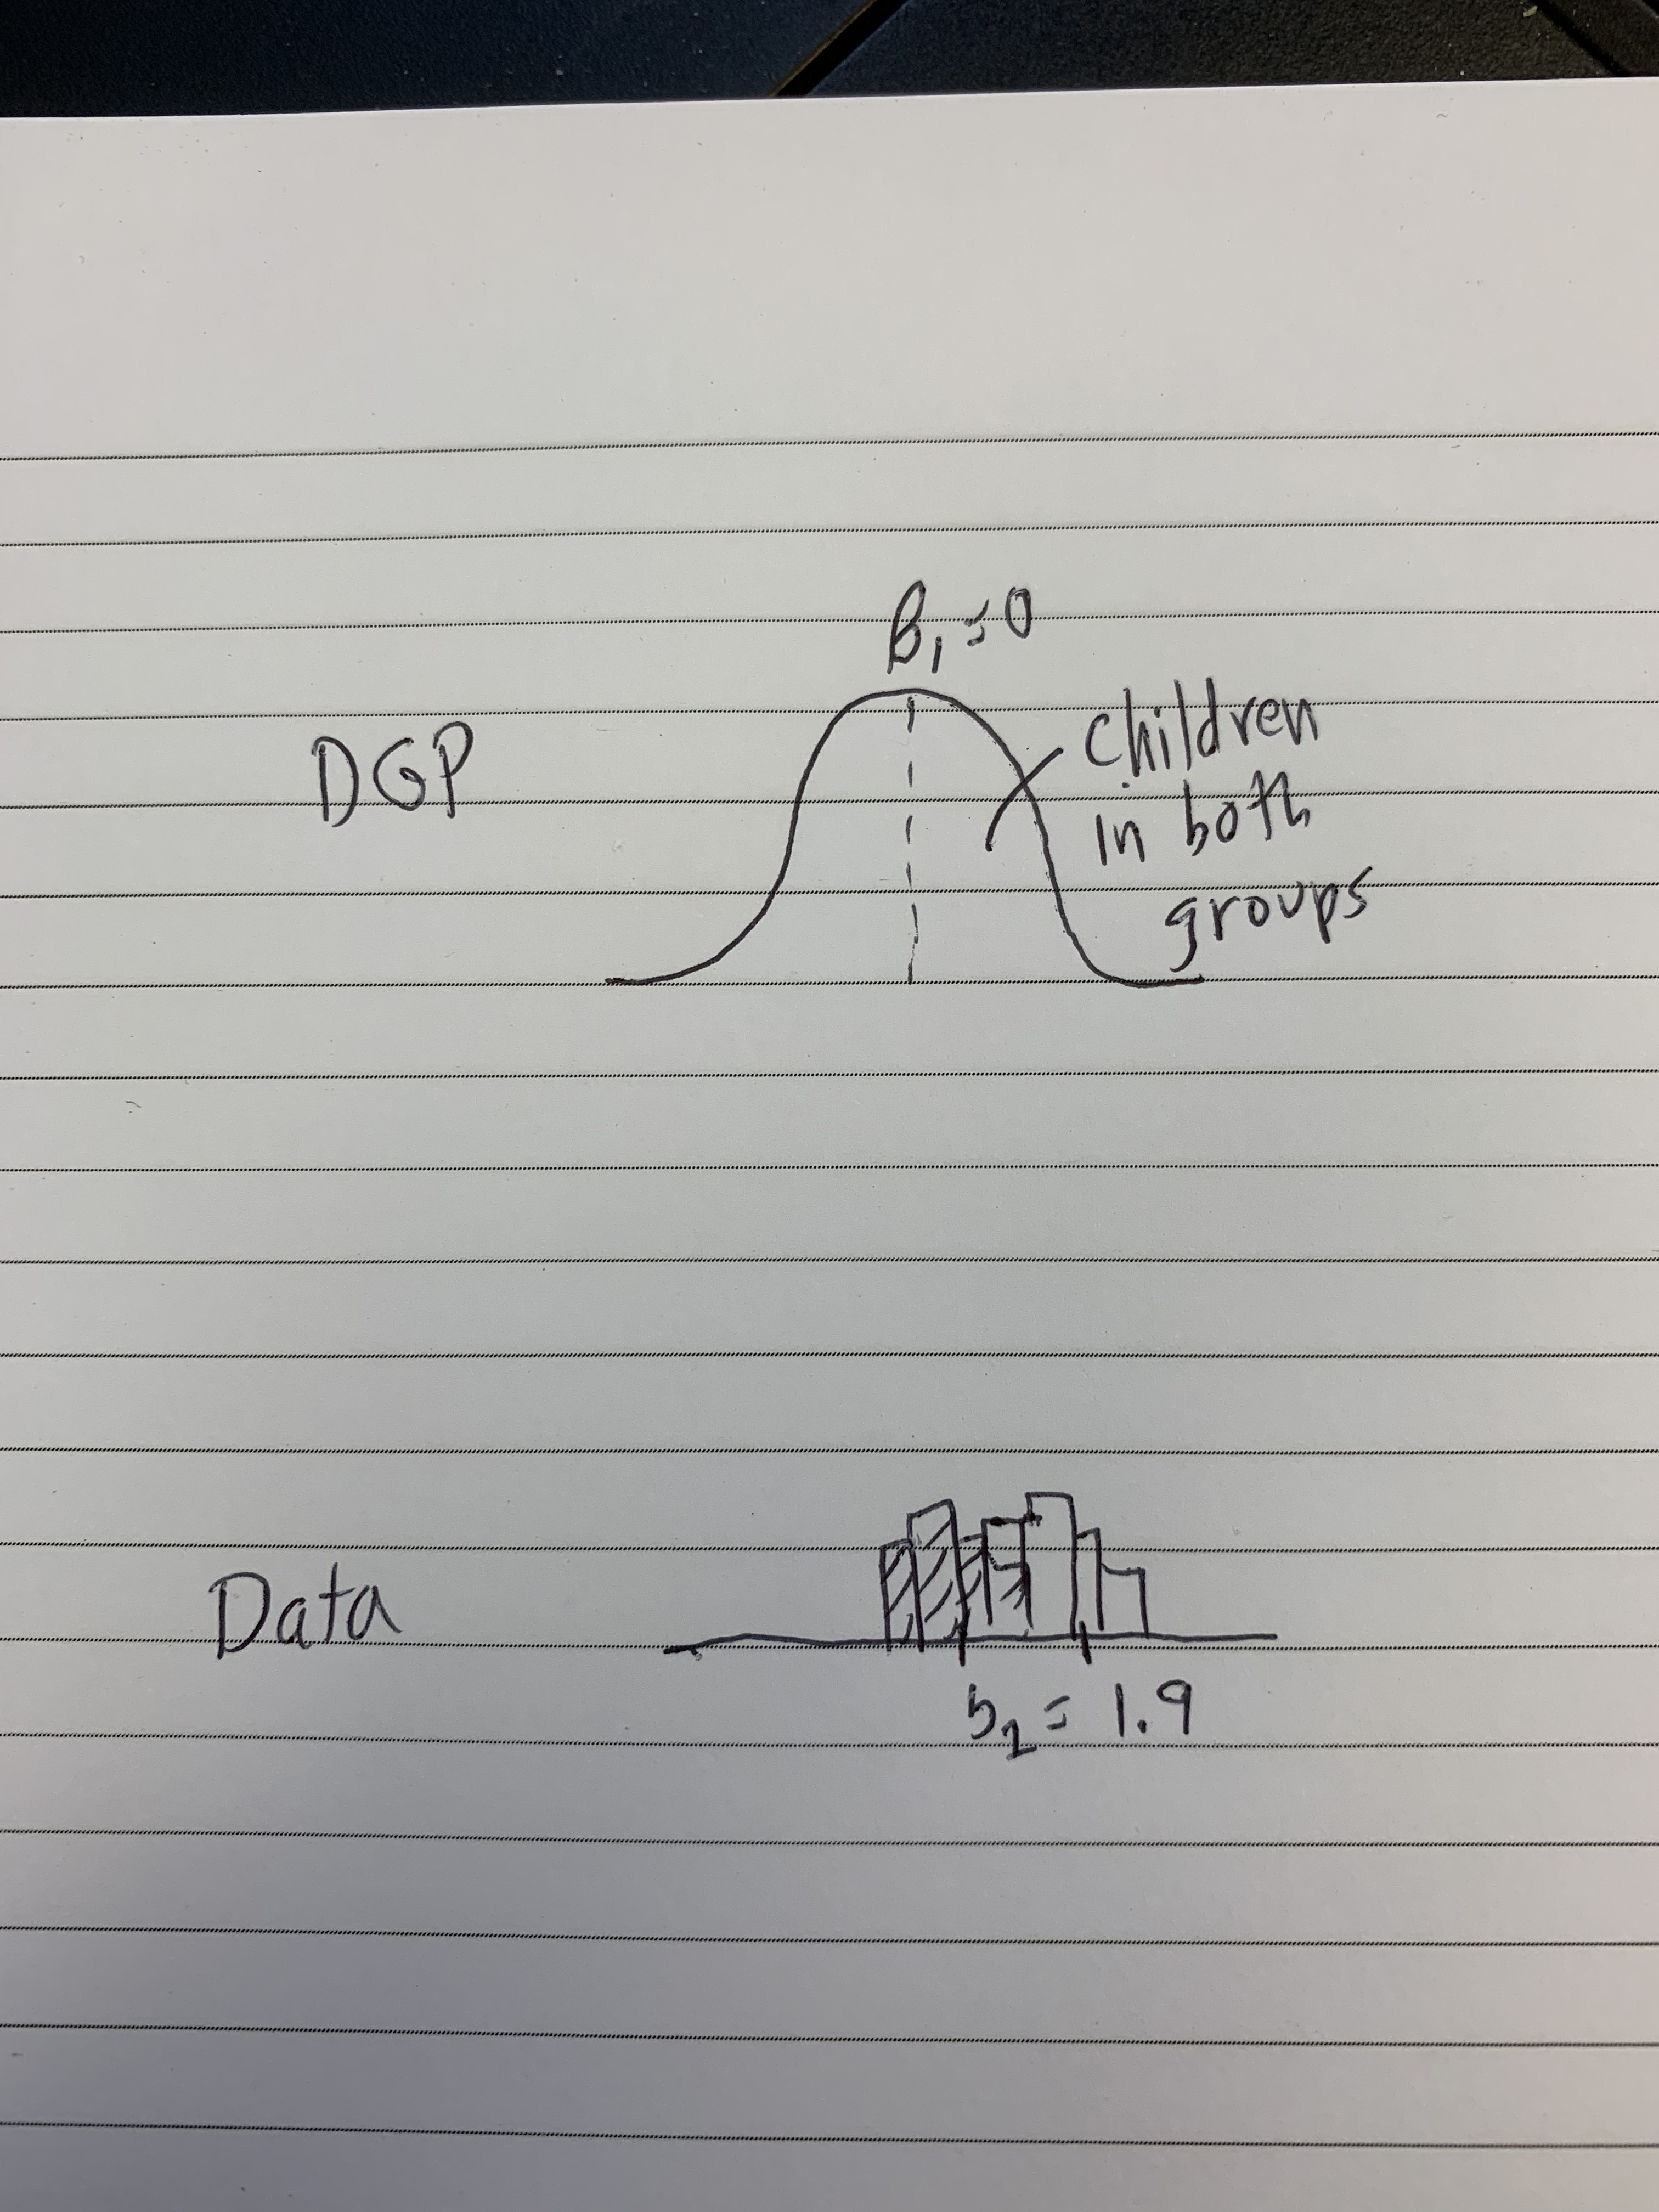
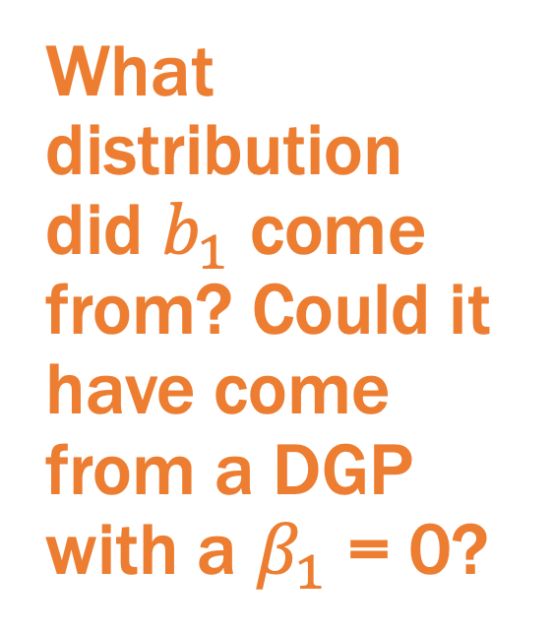
My Picture
What distribution did $b_{1}$ come from? Could it have come from a DGP with a $β_{1}$ = 0?

Slide 12
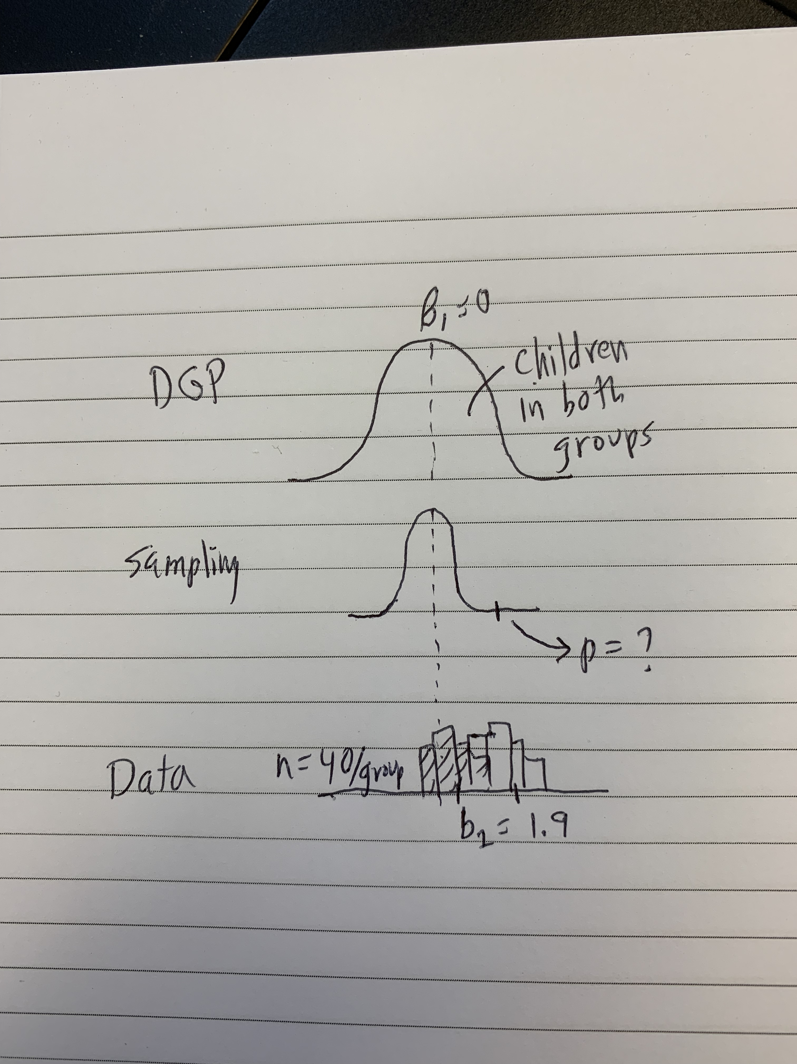

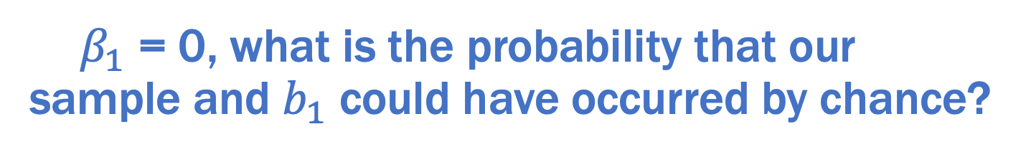
My Picture with Sampling Distribution
What distribution did $b_{1}$ come from? Could it have come from a DGP with a $β_{1}$ = 0?
If ${ β}_{1}$ = 0, what is the probability that our sample and $b_{1}$ could have occurred by chance?

Slide 13
We have a number of ways to model sampling distributions:
With R:
Simulation (rnorm)
Randomization (shuffle)
Bootstrapping (resample)
Mathematical models

Slide 14
Simulating a Sampling Distribution of b1

Slide 15

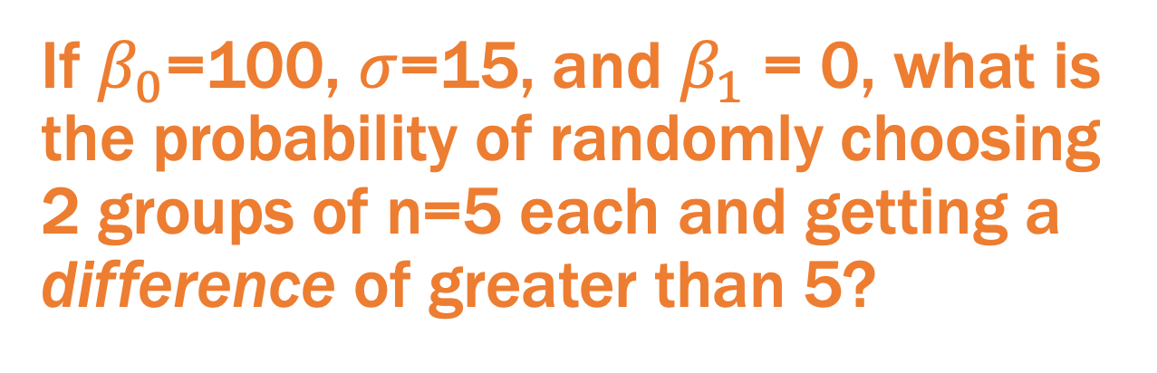

A new question
If $β_{0}$=100, $σ$=15, and $β_{1}$ = 0, what is the probability of randomly choosing 2 groups of n=5 each and getting a difference of greater than 5?
If ${ β}_{1}$ = 0, what is the probability that our sample and $b_{1}$ could have occurred by chance?
Draw a Picture to Represent this Question

Slide 16
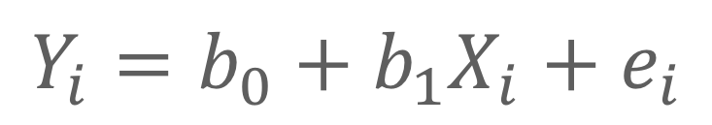

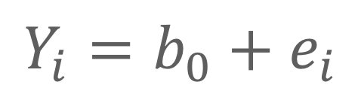
Casting the Question as Model Comparison
Two-group model:
$$Y_{i}=b_{0}+b_{1}X_{i}+e_{i}$$
Empty model:
5
$$Y_{i}=b_{0}+e_{i}$$
Question: What are the chances that our sample estimate $b_{1}$could have come from a DGP with $β_{1}$= 0?

Slide 17
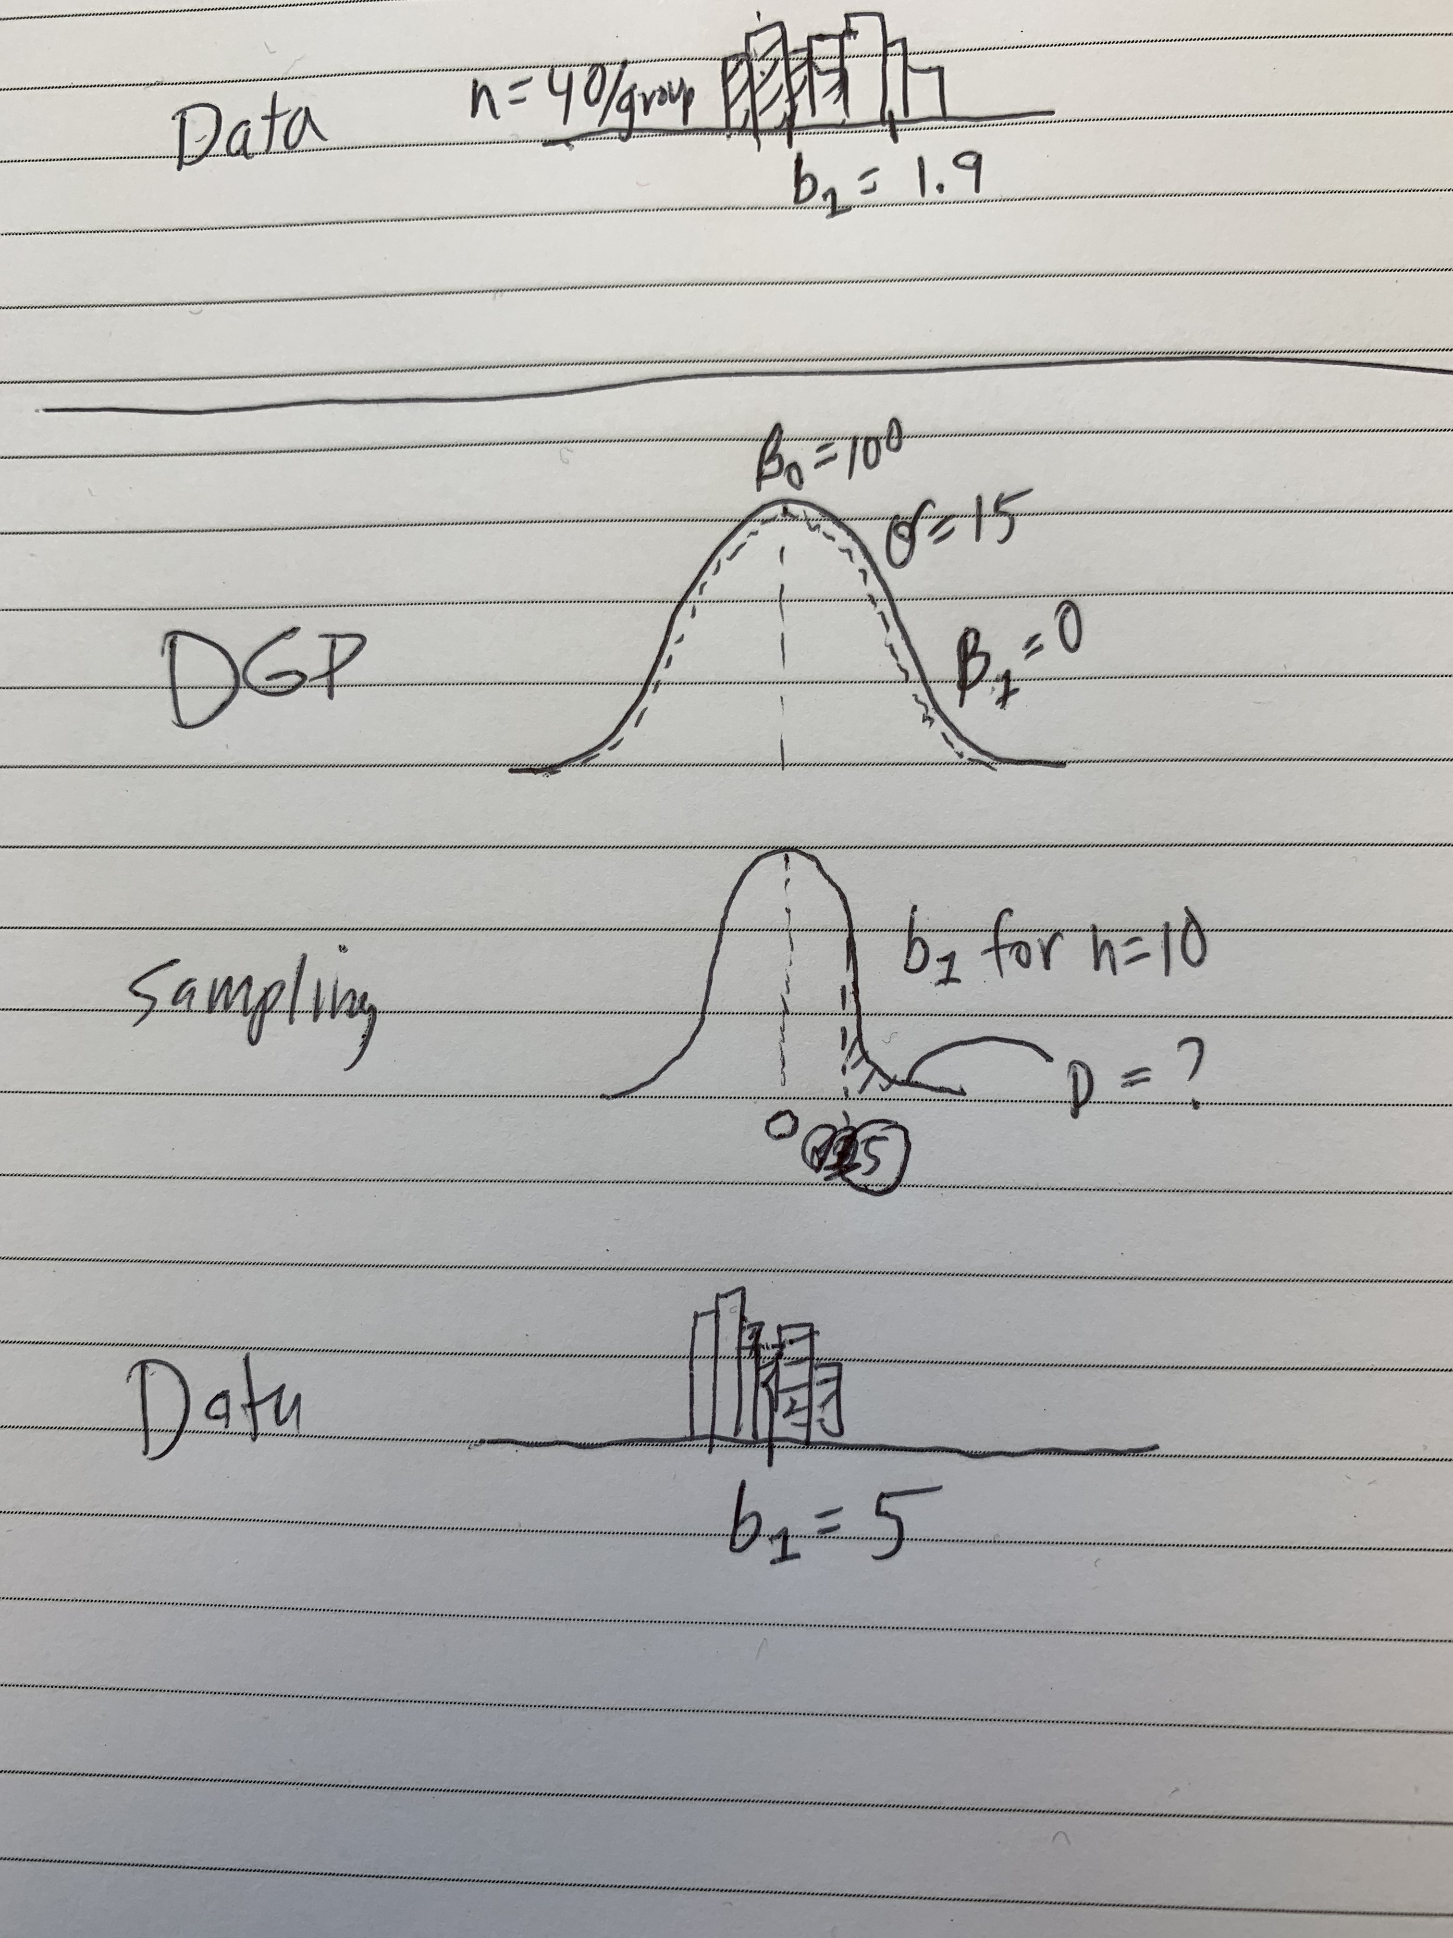
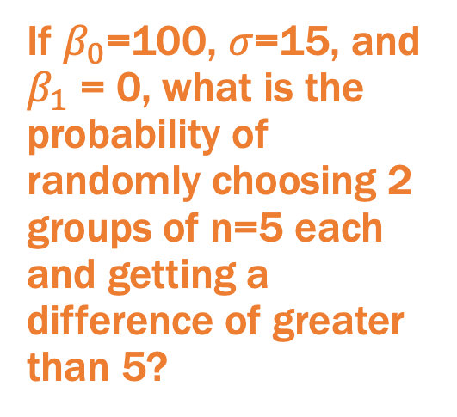
My Picture
If $β_{0}$=100, $σ$=15, and $β_{1}$ = 0, what is the probability of randomly choosing 2 groups of n=5 each and getting a difference of greater than 5?
To answer this question we need to simulate this sampling distribution.

Slide 18
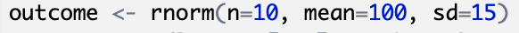
What does this code do?
Draw a picture

Slide 19

What does this code do?
If we run this code…

Slide 20
A sample of 10 observations with a mean of 100
A sample of 10 observations, but can’t tell the mean
A normal distribution with a mean of 100
A normal distribution but can’t tell the mean

Slide 21
Simulation:
Exploring the random DGP

Slide 22
If I change n from 10 to 100, what do you predict will change about the mean of the sample?

Slide 23
Should be closer to 100 on average
Should be further from 100 on average
Should not be different because it is still coming from the same DGP
Impossible to predict anything

Slide 24
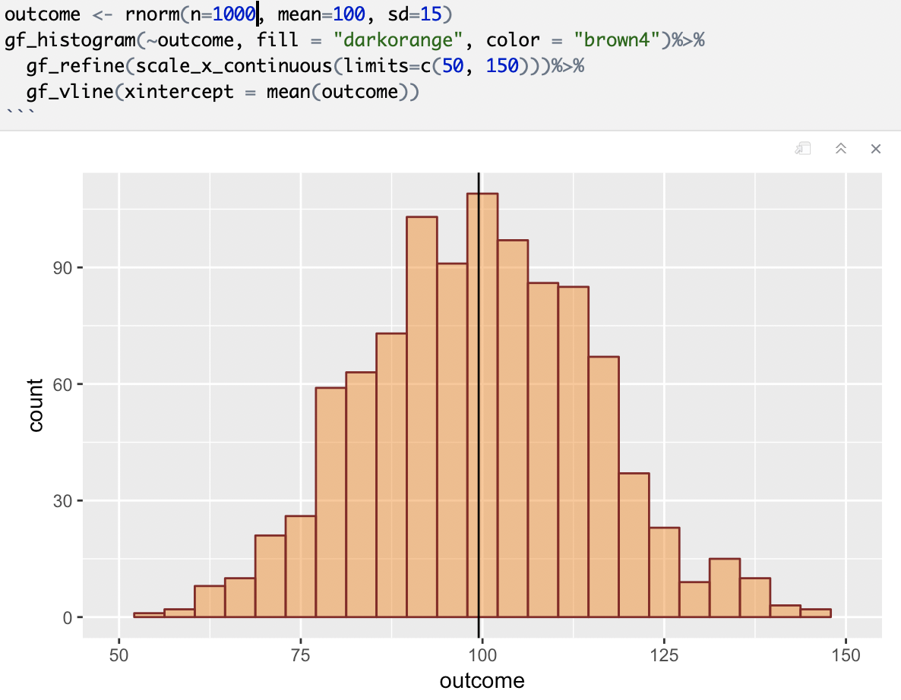
What if I change to n=1000?
Is this a sampling distribution?
Why or why not?

Slide 25
Yes
No
Not sure

Slide 26
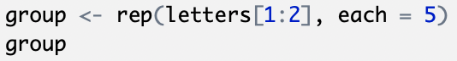
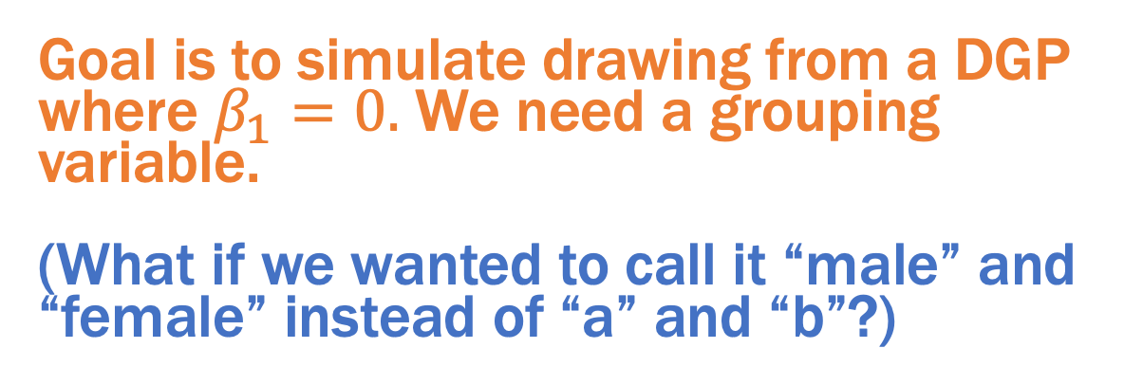
Goal is to simulate drawing from a DGP where $β_{1}=0.$ We need a grouping variable.
(What if we wanted to call it “male” and “female” instead of “a” and “b”?)

Slide 27
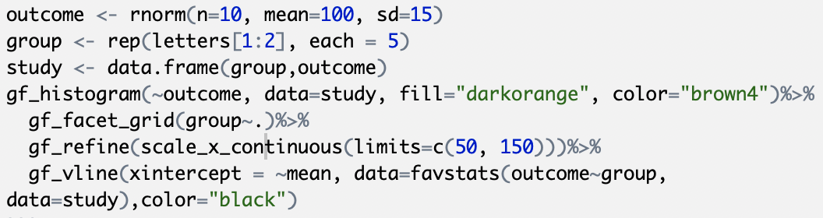
Let’s expand our code to put outcome and group as two variables in a data frame

Slide 28
What’s missing if we want to construct a sampling distribution?

Slide 29
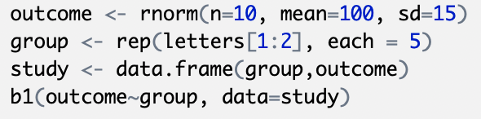
Add a line of code to get b1

Slide 30
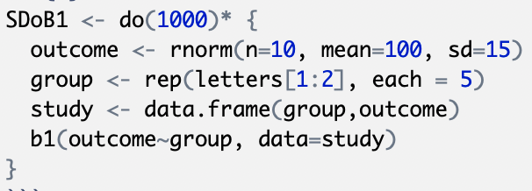
Constructing a Sampling Distribution of b1s…

Slide 31
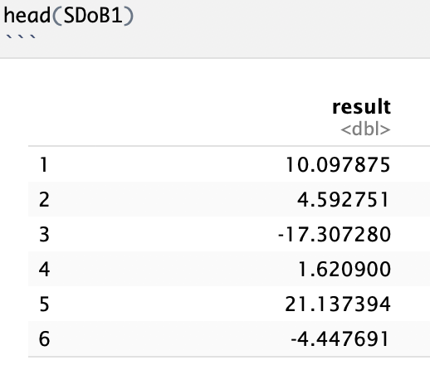
Look at head() of SDoB1.
What does each of these numbers represent?

Slide 32
One data point drawn from the DGP
The mean of one sample of n=10 drawn from the DGP
The group difference between group a and b for a sample of n=10 drawn from the DGP
The mean of the sampling distribution of b1

Slide 33
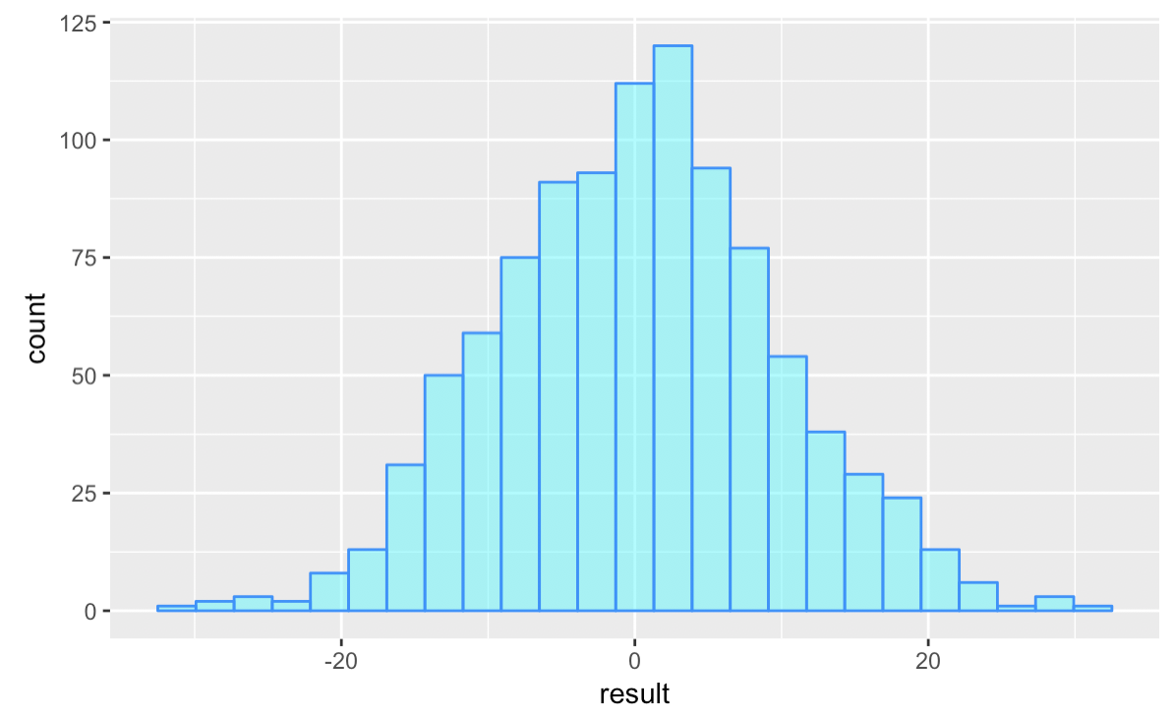
Sampling distribution of b1: What is “count” the count of?
Why do you think this distribution is centered at 0?

Slide 34
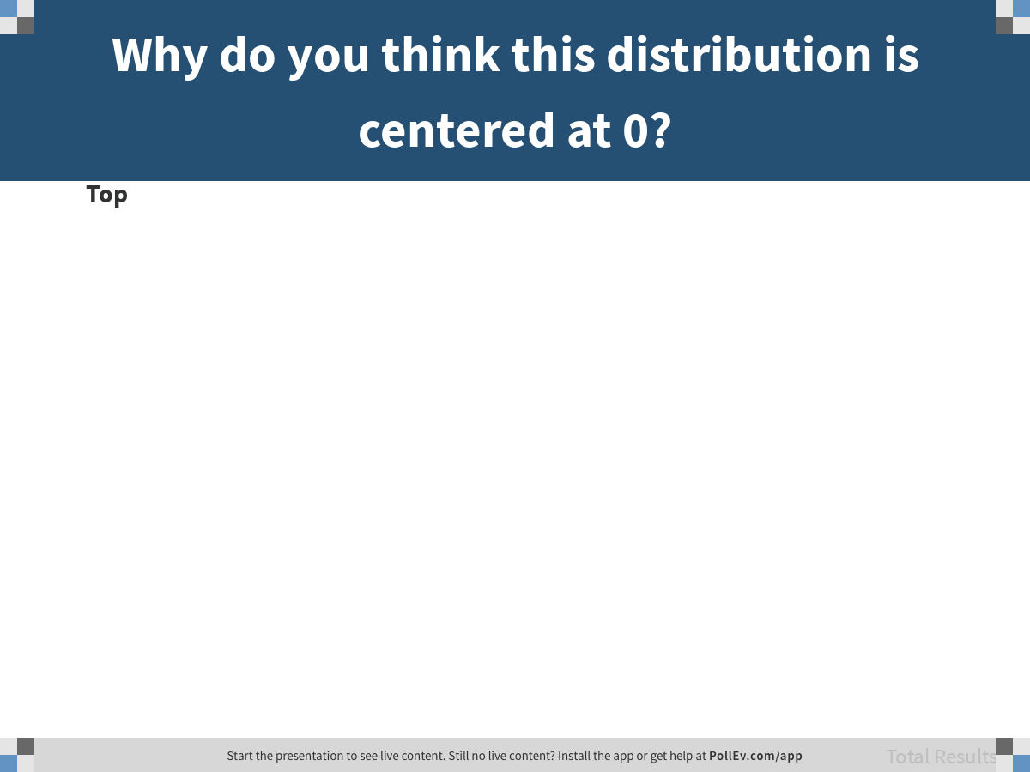
Notes:
Why do you think this distribution is centered at 0?
https://www.polleverywhere.com/discourses/I3FvmINAvLtyWGkAayMt0

Slide 35
Learning to think with “If…”

Slide 36
Remember our question
If $β_{0}$=100, $σ$=15, and $β_{1}$ = 0, what is the probability of randomly choosing 2 groups of n=5 each and getting a difference of greater than 5?
To answer this question we need to use the sampling distribution we just simulated.

Slide 37
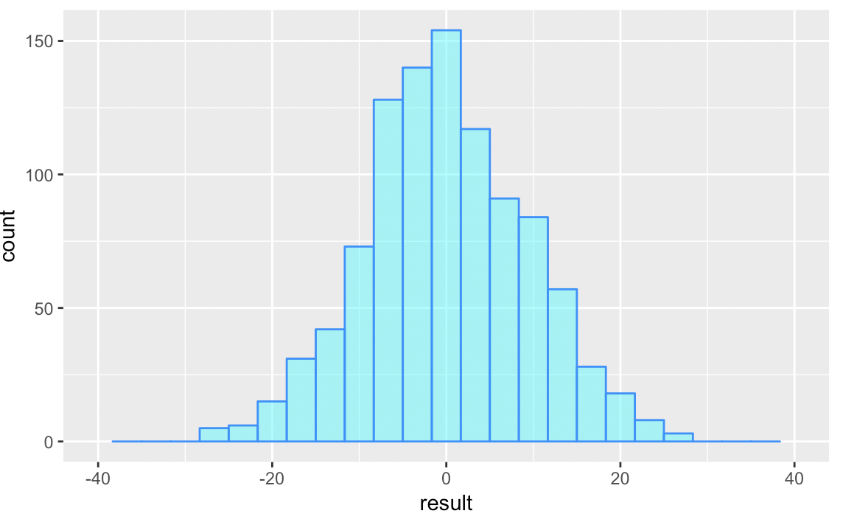
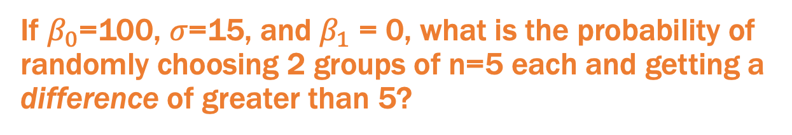
We use a sampling distribution to answer this question
If $β_{0}$=100, $σ$=15, and $β_{1}$ = 0, what is the probability of randomly choosing 2 groups of n=5 each and getting a difference of greater than 5?
p = ?

Slide 38
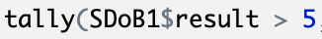
We use a sampling distribution to answer this question
If $β_{0}$=100, $σ$=15, and $β_{1}$ = 0, what is the probability of randomly choosing 2 groups of n=5 each and getting a difference of greater than 5?
p = ?

Slide 39
Casting the Question as Model Comparison
Two-group model:
$$Y_{i}=b_{0}+b_{1}X_{i}+e_{i}$$
Empty model:
5
$$Y_{i}=b_{0}+e_{i}$$
Question: What are the chances that our sample estimate $b_{1}$could have come from a DGP with $β_{1}$= 0?

Slide 40
Some more “what if”s

Slide 41
How would probability be affected by…
Increasing sample size
Increasing DGP mean from 100 to 120
Changing DGP SD to 10 from 15
Etc.
Draw what you think will happen. Then run the code to find out.

